Slide 1
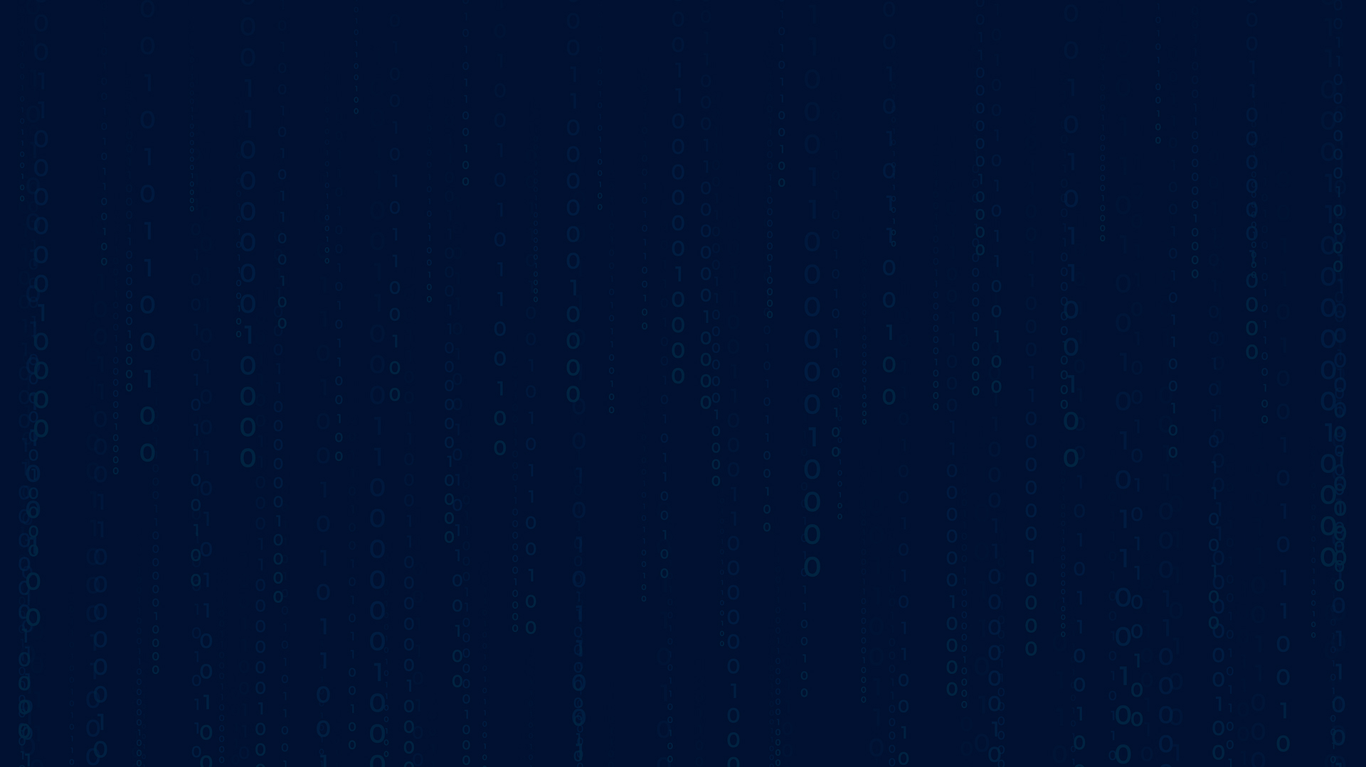




PERSONALIZED TREATMENT
RECOMMENDATIONS
NAME: KISHORE KUMAR G K Guide: P.RAJA
EMAILID: kumargkkishore@gmail.com Master Trainer,
Edunet Foundation
Disclaimer: The content is curated for educational purposes only.
Notes:
Slides: Prepare a short slide deck (10-12 slides) summarizing the project objectives, methodology, and key results.

Slide 2
OUTLINE
Abstract of the Project
Problem Statement
Proposed Solution
System Architecture
Live Demo of the Project
Embedded Video of Project
Conclusion
Future Scope

Slide 3
Abstract
This project focuses on developing a Personalized Treatment Recommendations
Web Application that empowers users with accessible, reliable health information and early
insights into potential health concerns. The application addresses the need for accurate,
preliminary health guidance for individuals experiencing symptoms. Leveraging the
increasing relevance of remote healthcare, the platform provides a quick and user-friendly
tool for symptom analysis to support proactive health decisions.
The main objectives of the project included creating an intuitive platform for
symptom entry, employing a Decision Tree Classifier to predict possible diseases, and
offering comprehensive health information, such as condition details, preventive measures,
and lifestyle advice. Built with a Flask-based framework, the application successfully
delivers accurate symptom-based predictions, providing meaningful health insights and
fostering health awareness. Future enhancements may include expanding the dataset,
integrating real-time data, and adopting advanced predictive models to improve accuracy
and accessibility in remote healthcare

Slide 4
Problem Statement
Build AI systems for analyzing patient symptoms data to provide personalized treatment, and recommendations and improve patient outcomes with Flask and Machine Learning The problem being addressed by this project is the lack of accessible, timely, and reliable health information for individuals experiencing symptoms but unable to immediately consult healthcare professionals. Many people face situations where they experience symptoms and want quick insights into what these symptoms could signify, yet they often struggle to find accurate resources or distinguish between potential illnesses due to overlapping symptoms.

Slide 5
Proposed Solution
Develop a user-friendly web application that allows individuals to input symptoms and
receive reliable, AI-driven predictions of potential illnesses, enhancing access to preliminary
health information Implement a Decision Tree Classifier model trained on symptom-disease data to accurately
predict possible diagnoses based on user-provided symptoms.
Offer users not only a diagnosis but also additional information about the predicted disease,
including descriptions, recommended precautions, medication advice, dietary suggestions,
and workout tips to support informed health decisions
Enhance the reach and effectiveness of remote healthcare by providing an accessible tool
that can support telemedicine consultations and serve as a preliminary diagnostic aid in
remote or underserved areas

Slide 6
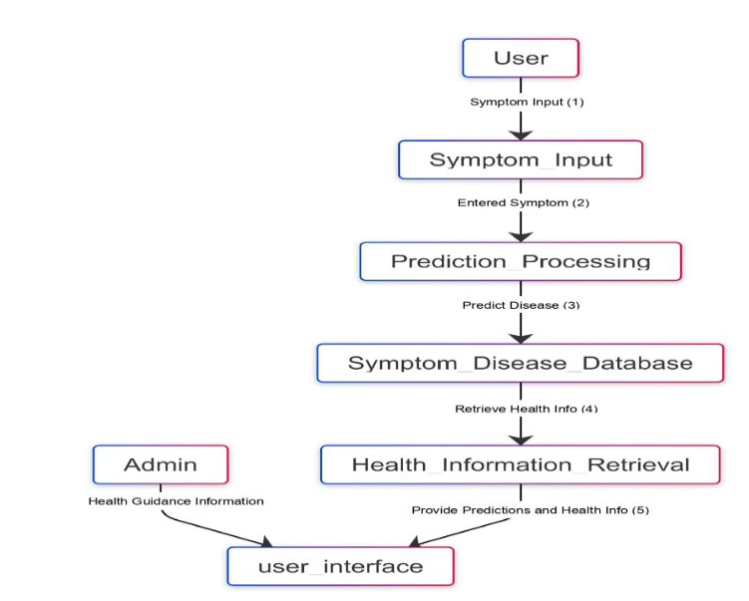
System Architecture

Slide 7
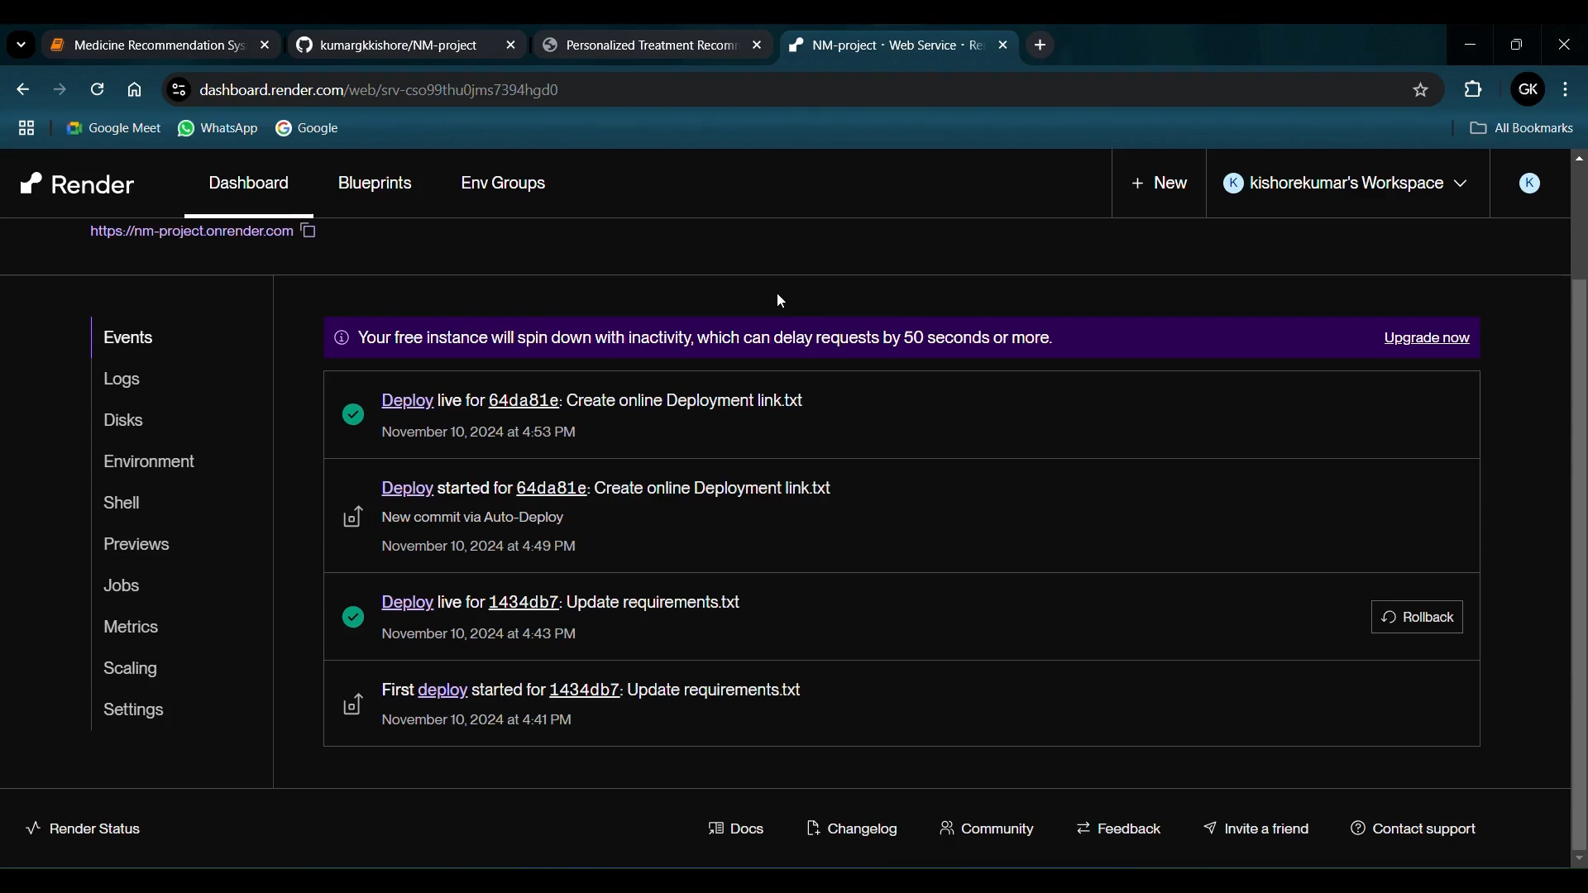
Live Demo of Project

Slide 8
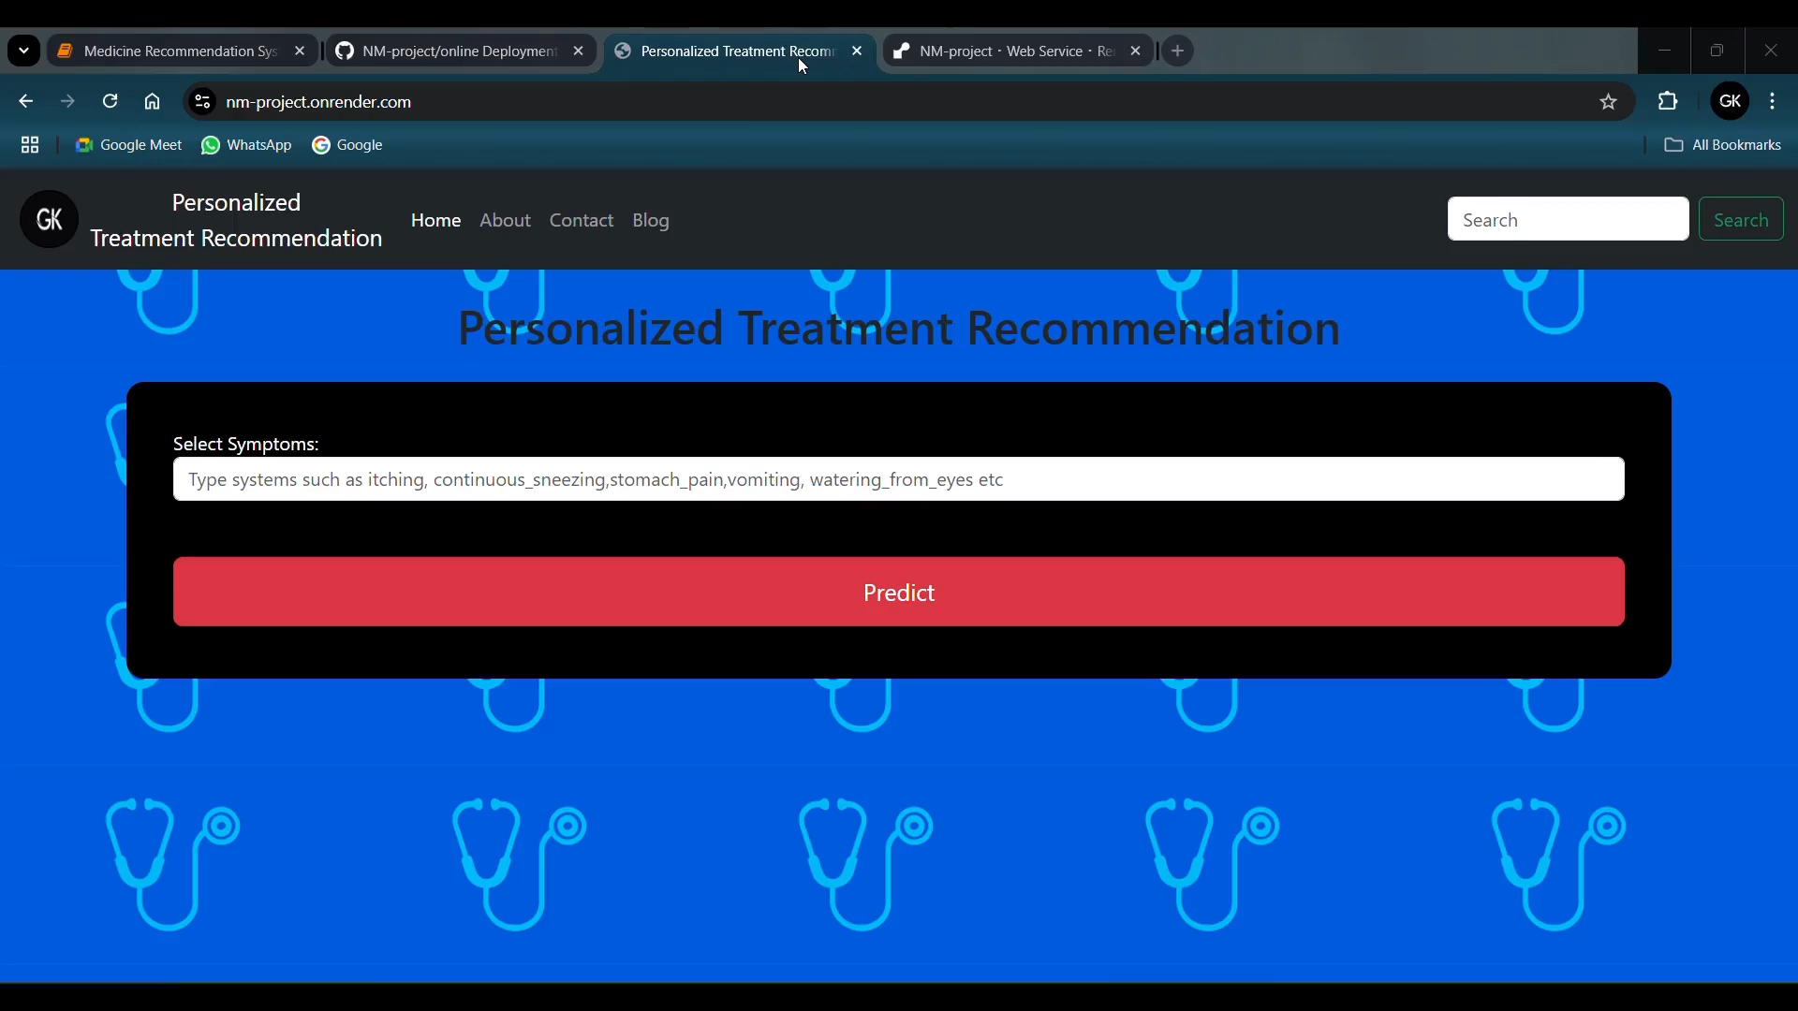
Video of Project Demo

Slide 9
Conclusion
The Symptom-Based Disease Diagnosis Web Application represents a significant
advancement in the intersection of technology and healthcare, providing users with an
innovative tool for understanding their health concerns. By leveraging machine learning
techniques, particularly a Decision Tree Classifier, the application offers quick and
accessible predictions based on reported symptoms, empowering individuals to make
informed decisions about their health.

Slide 10
Future Scope
Enhance the Dataset
Diverse Data Collection: Expand the dataset to include a broader range of
symptoms, diseases, and demographic information. Collaborate with healthcare
institutions to gather real-world patient data, ensuring that rare diseases and varied
presentations are included.
Improve Model Complexity
Advanced Machine Learning Techniques: Explore more complex machine
learning models, such as Random Forest, Gradient Boosting, or Neural Networks,
which may provide better accuracy for nuanced symptom-disease relationships.
Integrate Real-Time Data
Incorporate Clinical Data: Develop functionalities that allow the application to
integrate with electronic health records (EHRs) to access comprehensive patient
histories, lab results, and imaging data. This would provide a more holistic view of
the user's health.

Slide 11
Thank you!
Notes:
thank you very much for joining this PPT, keep learning.
11

